Slide 1
KP Calibration Weekly Report
Week 35 - 28th August 2020

Slide 2
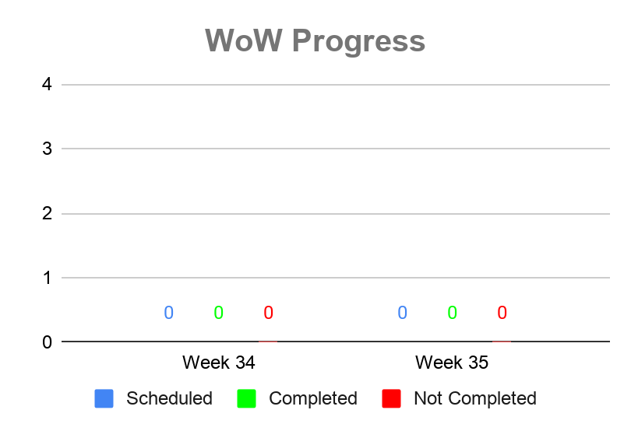
Calibration
Not Completed Summary
Week 34
Reason Not Completed | COUNTA of KP Serial No
Grand Total
No Scheduled Calibration on Week 34
Week 35
Reason Not Completed | COUNTA of KP Serial No
Grand Total
No Scheduled Calibration on Week 35
0
0
0
Scheduled
Completed
Not Completed
Source Data

Slide 3
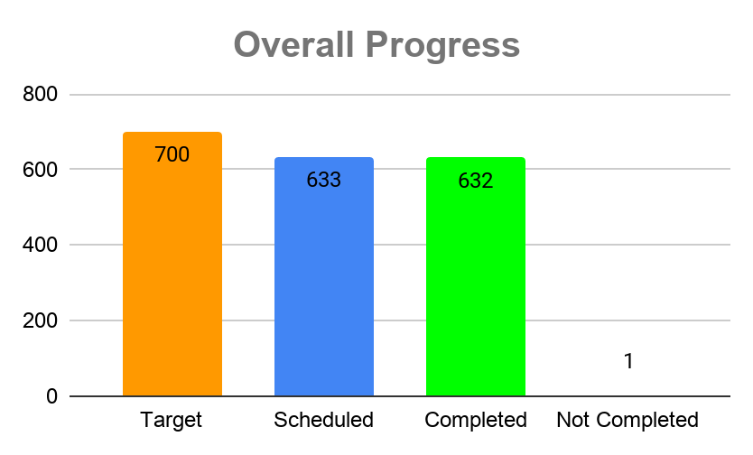
Overall Calibration
Not Completed Summary
Reason Not Completed | COUNTA of KP Serial No
Shop Closed | 1
Source Data

Slide 4
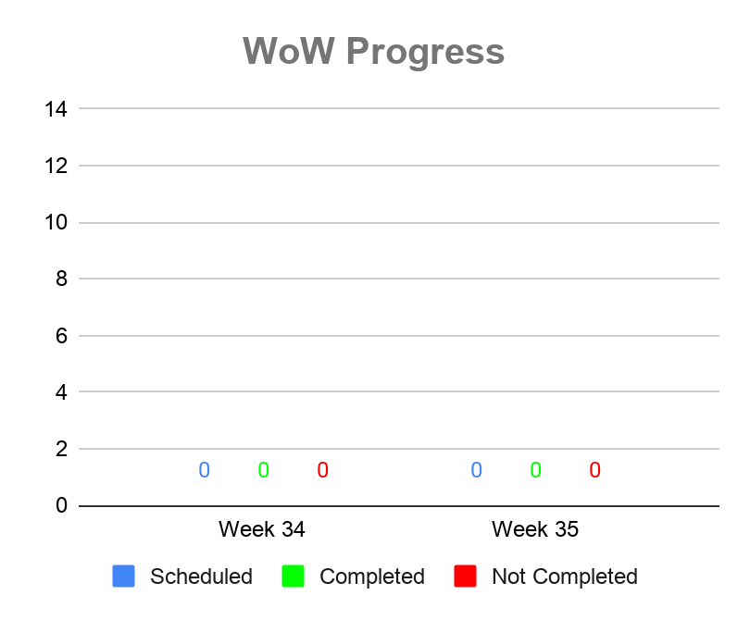
System Group Limited Initial Verification
Not Completed Summary
Week 34
Reason Not Completed | COUNTA of KP S/N
Grand Total
No Scheduled System Group Verification and Sealing on Week 34
Week 35
Reason Not Completed | COUNTA of KP S/N
Grand Total
No Scheduled System Group Verification and Sealing on Week 35
0
0
0
Scheduled
Completed
Not Completed
Source Data

Slide 5

Overall System Group Limited Initial Verification
Not Completed Summary
Reason Not Completed | COUNTA of KP S/N
Grand Total
Source Data

Slide 6
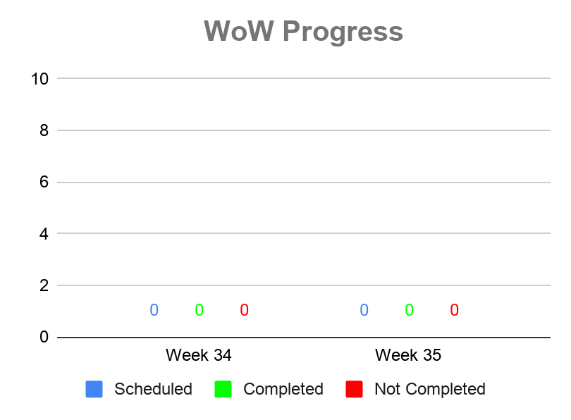
Initial Weights and Measures Verification
Not Completed Summary
Week 34
Reason Not Completed | COUNTA of KP Serial No
Grand Total
No Scheduled W&M on Week 34
Week 35
Reason Not Completed | COUNTA of KP Serial No
Grand Total
No Scheduled W&M on Week 35
0
0
0
Scheduled
Completed
Not Completed
Source Data

Slide 7
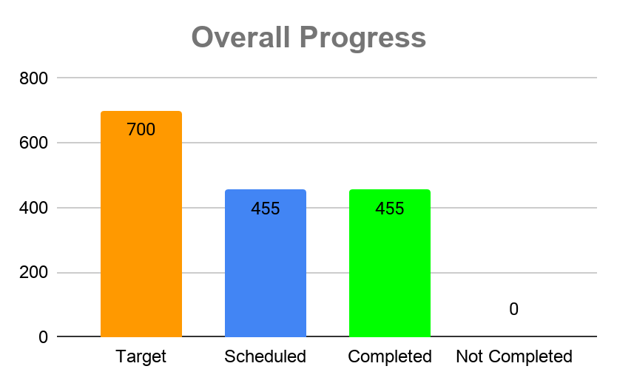
Overall Initial Weights and Measures Verification
Not Completed Summary
Reason Not Completed | COUNTA of KP Serial No
Grand Total
Source Data

Slide 8
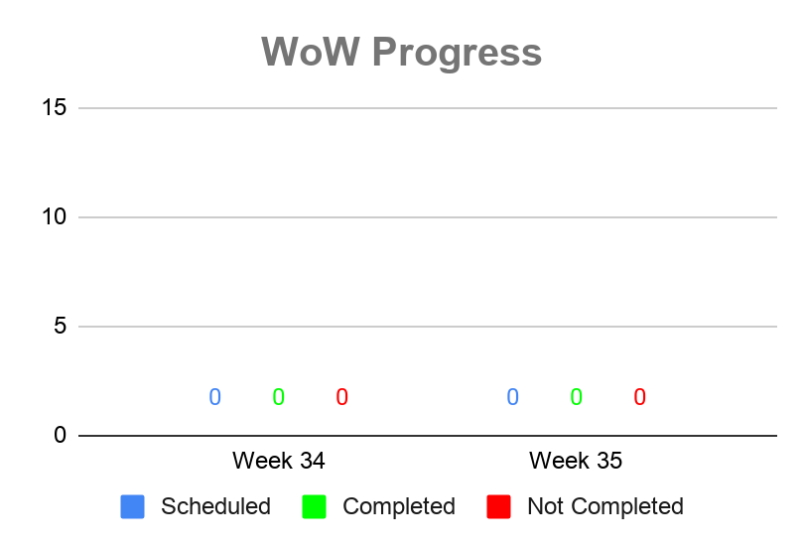
3 Month Verification
Not Completed Summary
Week 34
Reason Not Completed | COUNTA of KP Serial No
Grand Total
No Scheduled 3 Month Verification on Week 34
Week 35
Reason Not Completed | COUNTA of KP Serial No
Grand Total
No Scheduled 3 Month Verification on Week 35
0
0
0
Scheduled
Completed
Not Completed
Source Data

Slide 9
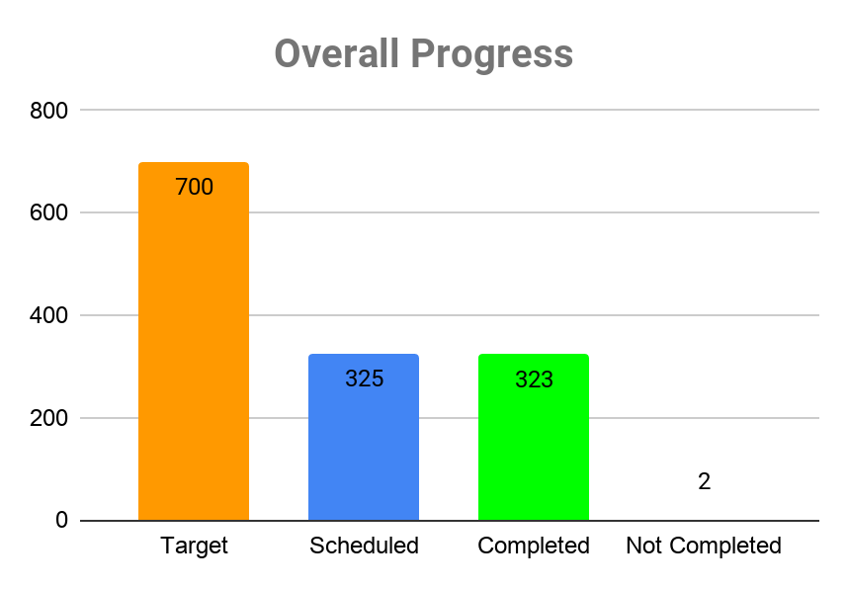
Overall 3 Month Verification
Not Completed Summary
Reason Not Completed | COUNTA of KP Serial No
Decommissioned | 2
Grand Total | 2
Source Data

Slide 10
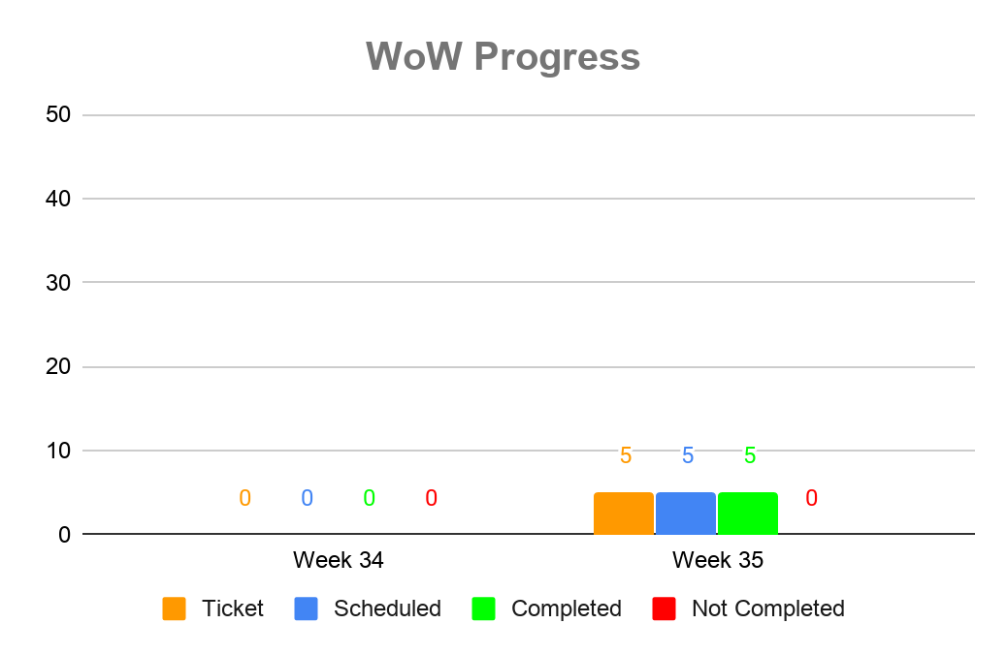
Validation
Not Completed Summary
Week 34
Reason Not Completed | COUNTA of KP Serial No
Grand Total
Week 35
Reason Not Completed | COUNTA of KP Serial No
Grand Total
5
5
5
Scheduled
Completed
Not Completed
Source Data

Slide 11
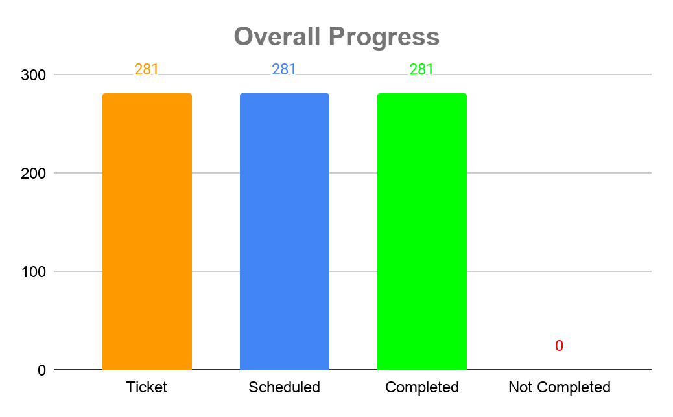
Overall Validation
Not Completed Summary
Reason Not Completed | COUNTA of KP Serial No
Grand Total
Source Data

Slide 12
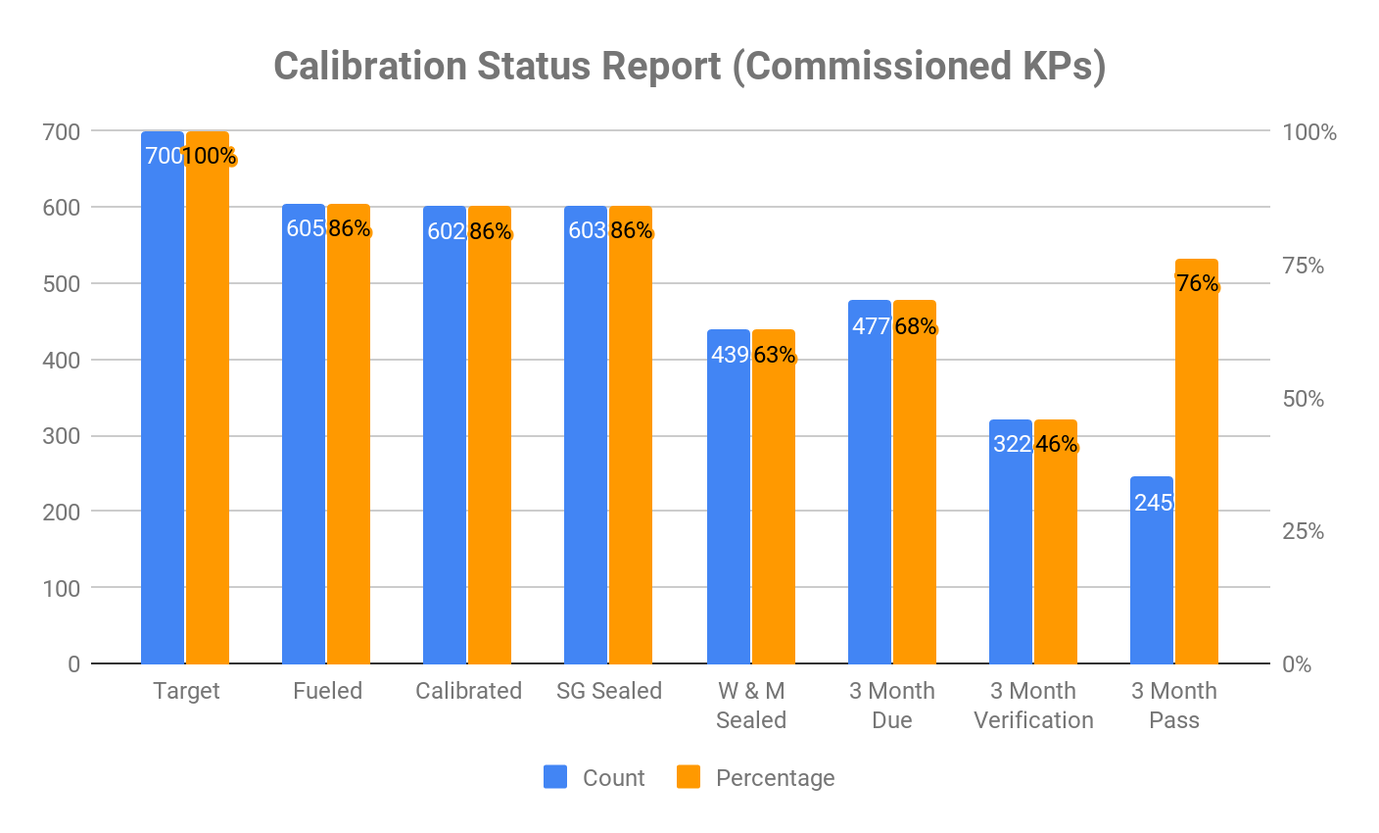
Overall Calibration Summary
Note: Calibrated KOKOpoints are total commissioned KOKOpoints.
3 Month Verification is dependent of 3 Month due.
3 Month Due is dependent of W&M Verified and Sealed and with a period of 3 month from time of verification and sealing.
Source Data

Slide 13

Thank you

